Slide 1


TITLE DEFENCE PRESENTATION
ML-BASED NETWORK MONITORING SYSTEMS
MUHAMMAD UMAR MAQSOOD 2022447 SHAMINA DURRANI 2022543
MUHAMMAD YOUNAS 2022456
SUPERVISOR:
DR. MUHAMMAD ZAIN SIDDIQI
CO-SUPRVISOR:
DR. KHURRAM JADOON
Ms Beenish, Lecturer

Slide 2


Can you guess the surge in the number of internet users each year?

Slide 3
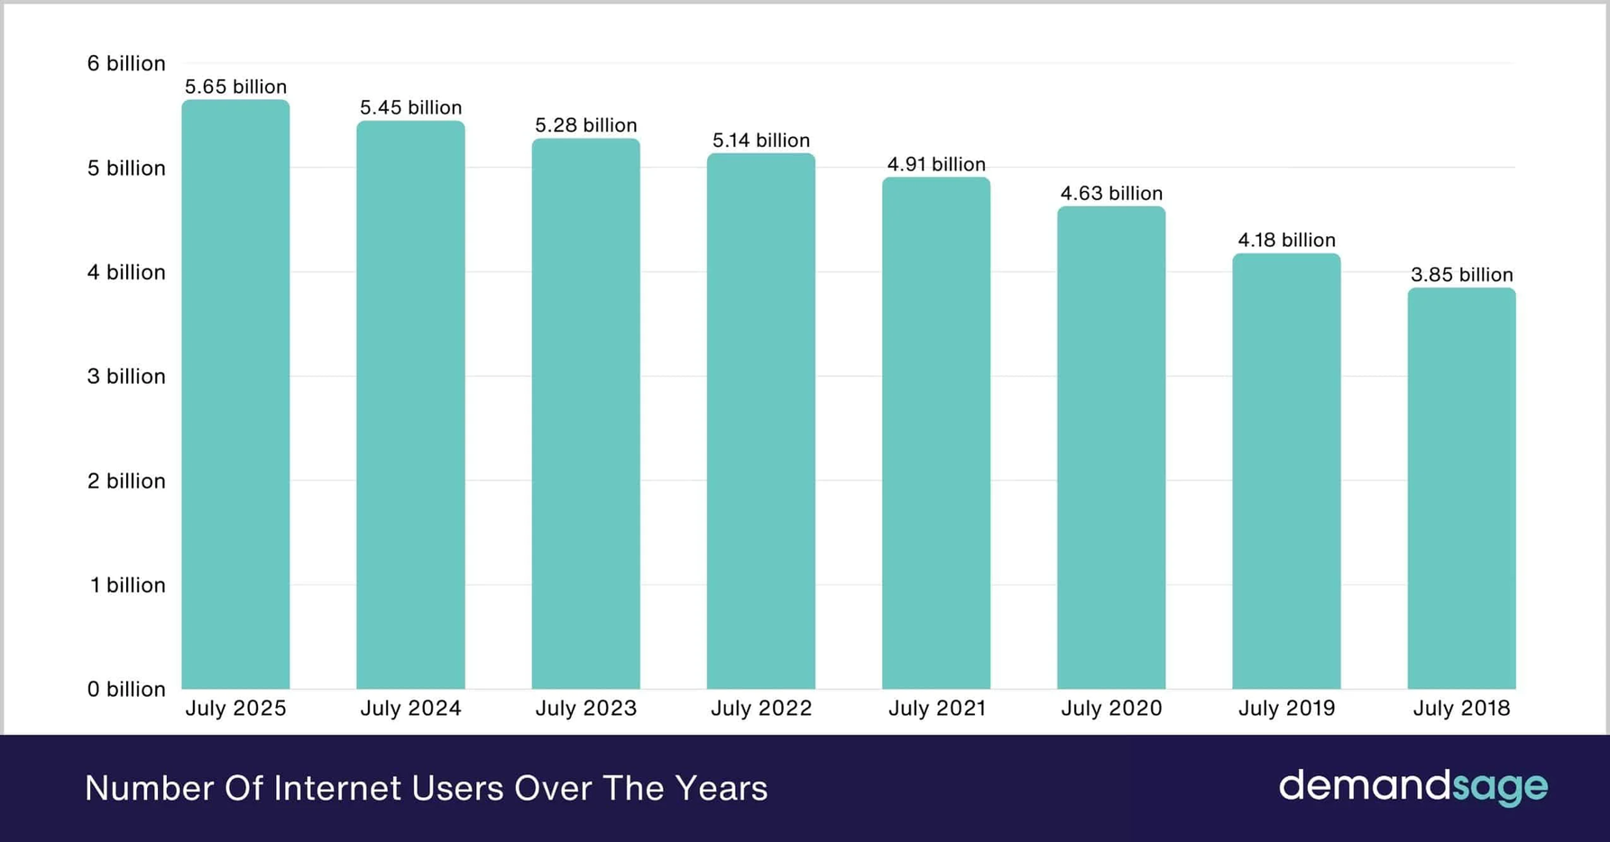
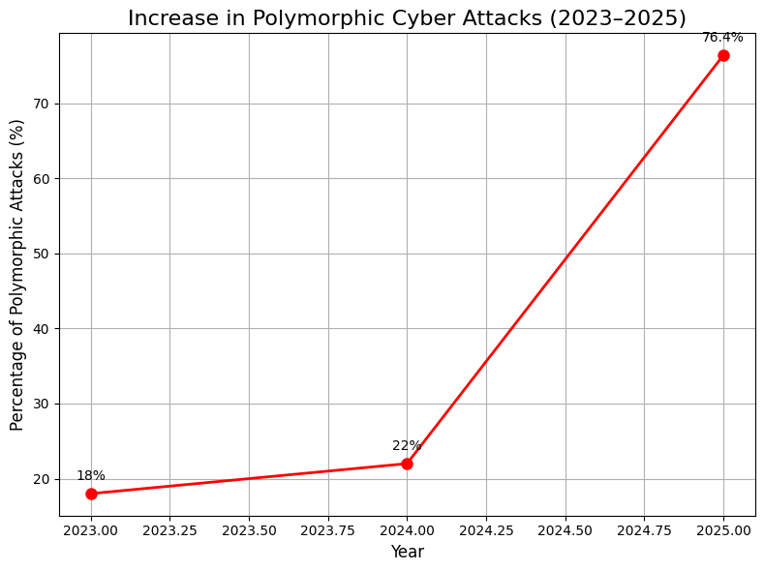
Background
1
Global cyber threats are increasing yearly by 25–30% (ENISA/Verizon reports).
Studies show that there is a magnificent increase of 70%-76% increase in polymorphic attacks last year.
https://www.demandsage.com/internet-user-statistics/
2
[3][4][5]

Slide 4
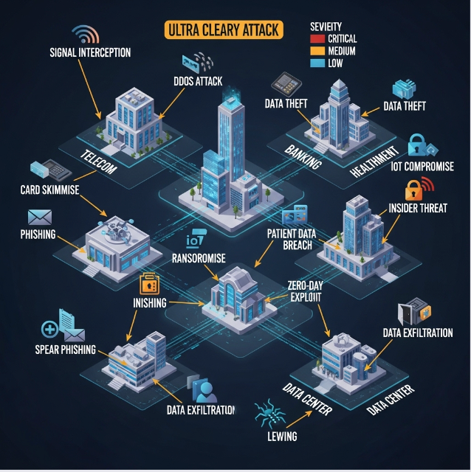
MOTIVATION
1
Traditional IDS tools rely on signatures and fail against evolving attack patterns.
Critical infrastructures (banking, telecom, healthcare) are highly exposed to cyber threats.
2
3
Delayed detection directly increases breach cost AND reduces trust in security controls.
There is a need for adaptive, ML-driven monitoring systems that evolve with threats.
4

Slide 5
Problem Statement
We aim to overcome the limitations of traditional intrusion detection systems such :
1
Static, signature based, can not detect novel attacks.
2
Too many incorrect alerts weaken security operation center (SOC) trust and reduce operational efficiency.
3
Remain static after deployment, cannot adopt to evolving threat landscape.

Slide 6
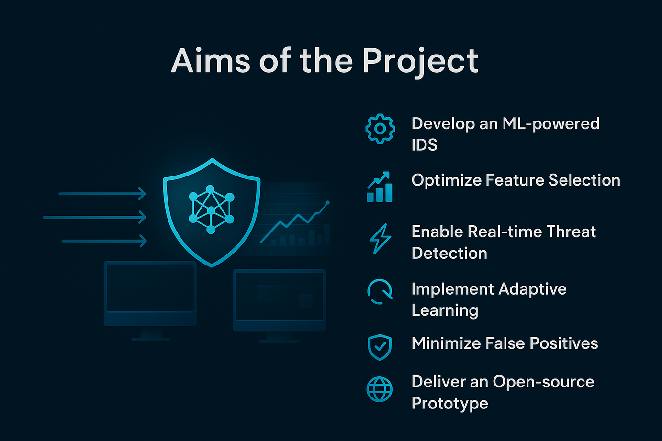
Objective
To replace static signature-based model with adaptive ML anomaly detection, so the system evolves as threats evolve.
1
To minimize delay in detection by designing real-time monitoring, so attacks are avoided before causing damage.
2
To optimize incorrect alerts through better feature engineering and balanced datasets.
3
To provide a monitoring dashboard with interpretable results, so enterprises can deploy it across critical infrastructures (banking, telecom, healthcare).
4

Slide 7
Scope
Our work is scoped to:
1
To avoid reliance on deep packet inspection and payload data.
2
To update models adaptively as new data is available.
3
To evaluate detection using both ML metrics (Precision, Recall, F1, ROC-AUC) and SOC metrics (False Alarm Rate, Detection Time).
4
This would be applicable in banking , telecom, home appliances e.t.c.

Slide 8
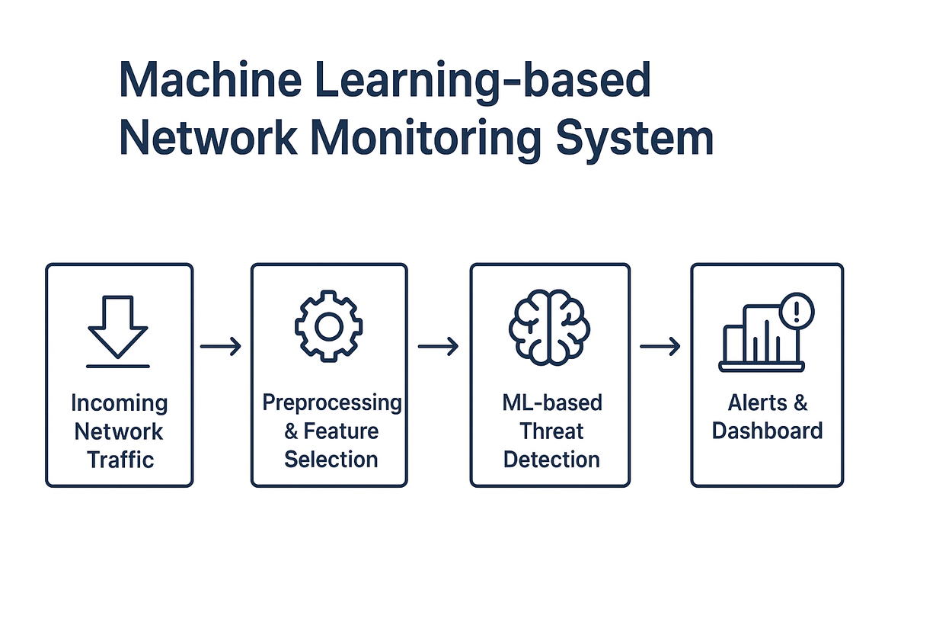
Project Overview
Addressing the limitations of traditional IDS by:
Detecting and analyzing anomalies in real time.
Reducing false positives while maintaining accuracy.
Ensuring adaptability to evolving threats.
Providing interpretable outputs for SOC teams.

Slide 9
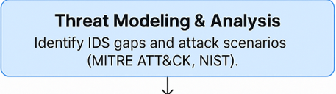
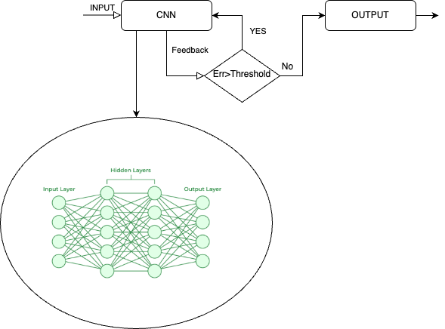
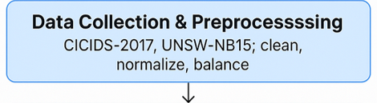
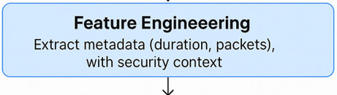
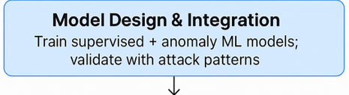
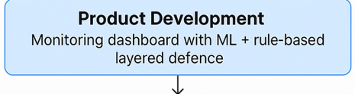
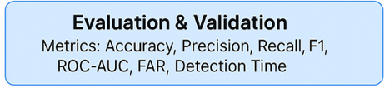
Methodology

Slide 10
Literature Review
Literature | Specifications | Novelty
[6] Deep Neural Network IDS on NSL-KDD | High accuracy, limited generalization | Metadata-first, encrypted-traffic ready
[7] Hybrid ML+DL pipelines | Near 100% accuracy but dataset overfitting | dataset validation
[8] End-to-end IDS frameworks | Lack explainability | Dashboard with interpretable alerts
[9] DL IDS focus on Accuracy only | No SOC metrics | Add FPR, Detection Time, Attack Coverage
[10][11] Static IDS (Snort, Suricata, Zeek) | Retraining required for new threats | Adaptive retraining model

Slide 11
MID TERM GOALS
Tasks
August
September
October
November
December
Literature Review
Initial Model Development
Model Design and Optimization
Dashboard Setup
Prototype Demonstration and
Midterm Review

Slide 12
References
[1] K. Kostas, "Anomaly Detection in Networks Using Machine Learning," Research
Proposal, 23 Mar 2018, 2018.
[2] “Internet Growth Statistics,” Miniwatts Marketing Group, 2 Mar 2018.
[3]ControlD, “Malware Statistics and Trends,”
[4]SQ Magazine, “AI Cyber Attacks Statistics: Polymorphic Malware Growth,”
[5]KnowBe4, “New KnowBe4 Report Reveals a Spike in Ransomware Payloads and AI-Powered Polymorphic Phishing Campaigns”

Slide 13
[6] S. T. Thirimanne et al., “Deep neural network based real-time intrusion detection system,” SN Comput. Sci., vol. 3, no. 2, art. 145, 2022.
[7] M. A. Talukder et al., “A dependable hybrid machine learning model for network intrusion detection,” J. Inf. Sec. Appl., vol. 72, p. 103405, 2023, arXiv:2212.04546.
[8] K. Potter and R. Shad, “Real-time network intrusion detection system using deep learning,” EasyChair Preprint, no. 14016, 2024.
[9] K. P. Kumar et al., “network based intrusion detection system using machine learning,” IJSREM, May 2025.
[10] I. Sharafaldin, A. H. Lashkari, and A. Ghorbani, “Toward generating a new intrusion detection dataset,” ICISSP, 2018. (CICIDS2017).
[11] N. Moustafa and J. Slay, “UNSW-NB15: ”A comprehensive data set for network intrusion detection systems,” MilCIS, 2015.

Slide 14
Thank You
FOR LISTENING.

